Slide 1
Story Road Bus Lane and Associated Improvements
VMT Exchange workshop 6/15/2018
Ramses Madou, City of San Jose
Robert Swierk, VTA

Slide 2
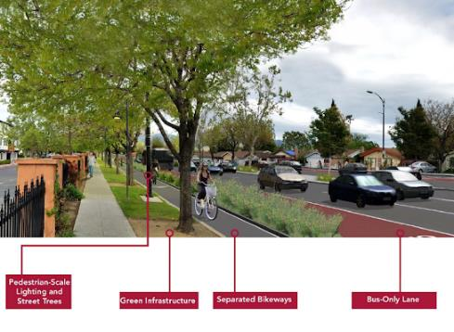
Project Description
2.75 mile bus lane on VTA 3rd highest line
Signal priority, shelters, amenities, intersection/crossing improvements
Cost ~$20.7 million (conceptual)

Slide 3
Evidentiary Basis
4 step travel time elasticity estimation method using mobile data source
Travel time analysis based on Streetlight data, VTA data & intersection operations
Origin Destination Analysis using Streetlight data & CSJ Travel Demand Model
Mode Shift analysis using auto and transit travel time elasticity estimates from National Cooperative Highway Research Program Report 535*
Vehicle-Miles Traveled (VMT) Analysis
Other approaches potential - travel demand modeling
*Dowling Associates (2005), Predicting Air Quality Effects of Traffic Flow Improvements: Final Report and User Guide, NCHRP 535, Transportation Research Board

Slide 4
Payment / Exchange / Inducement Required
Development projects could pay into fund or construct a portion of project
Private funding could leverage grants/public funds
Potential mechanisms:
CEQA mitigation for VMT (or transit) impact
Particularly for projects that can’t locally mitigate
Community Benefit or Voluntary Contribution
Condition of Approval on frontage (with nexus)

Slide 5
Types of Entities Interested
Development applicants:
Within San José - on corridor or served by transit routes that benefit
Outside San José - have VMT impacts and near San José limits, or served by transit routes
Cities (San José or neighboring) developing area plans with VMT or transit impacts

