Slide 1
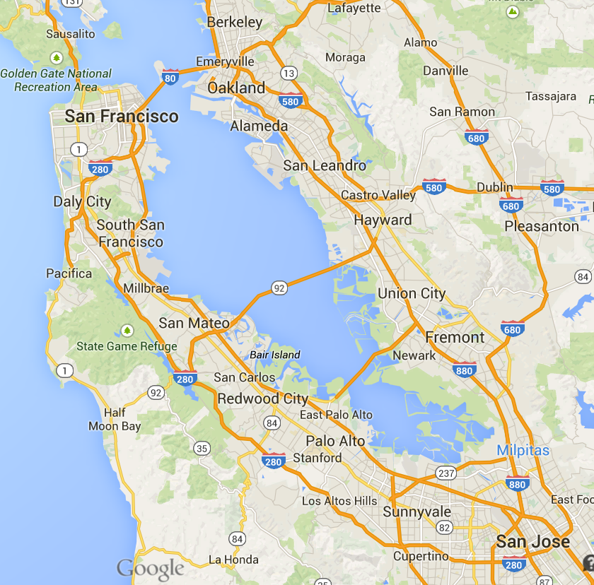
Case Study: North Bayshore
Mountain
View

Slide 2
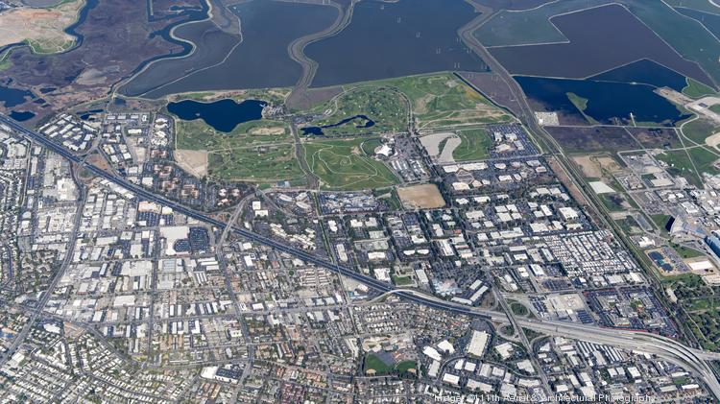

Slide 3
Employer business case:
Saved land and construction costs
Community relations
Employee recruitment and retention
Employee productivity
City business case:
Less traffic
More economic development
Happier citizens

Slide 4
Then why is Real TDM
Illegal?

Slide 5
Real TDM requires cities:
Eliminate minimum parking requirements
Manage parking
Don’t use density control as traffic management proxy: cap trips directly
Reward best players
Right size roads
Require roads be walkable and bikeable
Fix performance measurements
Collect and report on data

