Slide 1
Sponsorship of U-Pass and Specialized Pass Programs
Devon Deming
Los Angeles County Metropolitan
Transportation Authority (LA Metro)
demingd@metro.net
(213) 922-7957

Slide 2
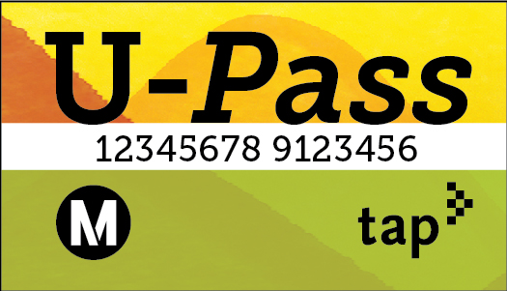
Project Description
Metro manages U-Pass and Specialized Pass Programs to increase transit Ridership and reduce traffic congestion
Pass programs utilize partnerships with schools, businesses, and organizations to distribute annual passes paid per year or boarding:
Universal College Student Pass (U-Pass)
Residential Transit Access Pass (RTAP)
Employer Annual Pass Program (EAPP)
Youth on the Move (YOTM) Foster Youth Program

Slide 3
Projected VMT Reduction
Program | Annual VMT Reduction | Calculation
U-Pass | Up to 5.4 million per school | 2,200 participants x 10 boardings per week x 52 weeks x 4.73 miles per boarding
RTAP | 1,589 per pass (816,746 for 514 total passes) | 28 trips per month x 12 months x 4.73 miles
EAPP | 1,589 per pass (26 million for 16,455 passes) | 28 trips per month x 12 months x 4.73 miles
YOTM | 1,703 per pass (1.6 Million for 945 passes) (30 Million for pilot program) | 28 trips per month x 12 months x 4.73 miles

Slide 4
Evidentiary Basis
Computation of the average trip length (miles) is accomplished by dividing the sum of the passenger miles by the sum of the boardings for the same period:
Total Monthly Passenger Miles July 17 through April 18 = 1,542,353,302
Total Monthly boardings July 17 through April 18 = 326,135,296
Current fiscal year to date the average trip length is 4.73 miles
Average weekly boardings and average cost per boarding are calculated based on actual boarding date from each program.
Average cost per boarding x average trip length (4.73) = cost per mile

Slide 5
Payment Required
Pass | Program | Cost | Calculation
ATAP | RTAP or EAPP | $0.76/mile | $1200 divided by (28 trips * 4.73 miles * 12 mos.)
EZ ATAP | RTAP or EAPP | $0.83/mile | $1320 divided by (28 trips * 4.73 miles * 12 mos.)
Senior | RTAP | $0.15/mile | $240 divided by (28 trips * 4.73 miles 12 mos.)
E-Pass | EAPP | $0.30/mile | $1.40 per boarding divided by 4.73 miles
YOTM | Existing | $0.65/mile | $1,101.38 divided by (30 trips * 4.73 miles 12 mos.)
YOTM | Pilot | $0.09/mile | $0.42 per boarding divided by 4.73 miles

Slide 6
Types of Entities Interested
Pass Program | Entities
U-Pass | School or development near a school
RTAP | Residential development or project adjacent to residential development
EAPP | Business who is also developer or working with developer
YOTM | Project adjacent to a school or that wants to impact youth

