Slide 1
New office development agreement requiring 50% SOV via zero-cost-to-employer carrot/stick policy called Fair Value Commuting (FVC)
Steve Raney, Joint Venture Silicon Valley
Related to Jeff Tumlin / North Bayshore

Slide 2
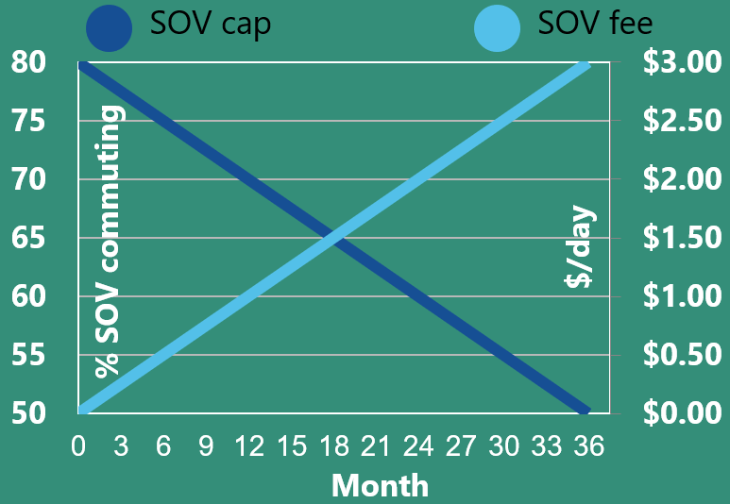
Description
Entitle office project ➔ developer agrees to lower SOV
Performance-based, declining SOV cap
Non-compliance ➔ no-cost-to-employer SOV feebate
Fee on SOV
Rebate to non-SOV
Vendor takes 15% of revenue.

Slide 3
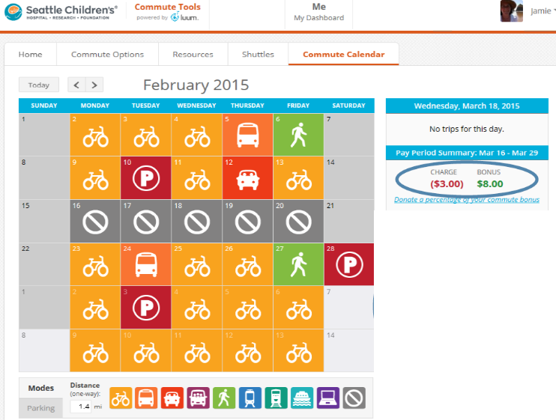
Description (cont)
Commute Software
Automates commute program
Per-employee calendar
SB1339 commute benefits
Employer-wide dashboard
50% mature
Scalable within 24 months
Automate mode detection.

Slide 4
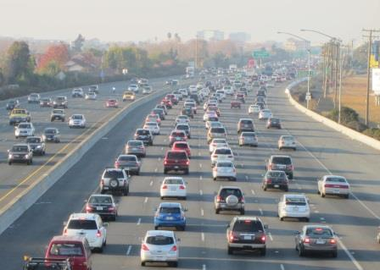
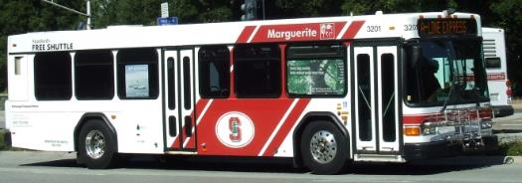
VMT Reduction Evidentiary Basis
75% to 50% SOV
Stanford U: similar to $3/day SOV feebate: 75 to 50%
Gates Foundation: $12/day SOV fee, $3/day non-SOV: 90 to 32%
Additional sources are listed.

Slide 5
Exchange Entities
FVC is zero net cost to employer
At 50% SOV:
SOV fee: $3/day (paid by employee)
Non-SOV rebate: $2.55 (paid to employee)
Vendor receives 15% ($0.45 per SOV commute)
Development agreement: developer & city
Restrictive lease: landowner & tenant.

Slide 6
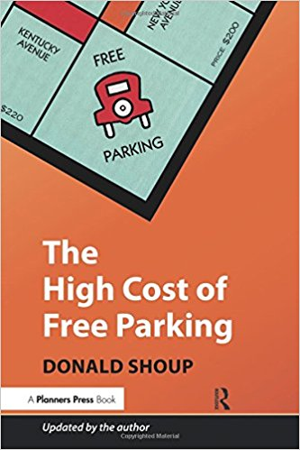
Regional Scalability
Enabling state bill: simple majority
50% SOV ordinance: supermajority of residents (per Prop 26)
At scale, for 2.9M Bay Area commuters, reduces
1M car trips/day
1.3M tons/GHG/year
3.4B VMT/year.
“Negative cost” of -$558/ton reduced
Creates $670M/year new revenue for non-SOV modes
Frees 3,700 acres of surface parking.

